Slide 1

Delhi's Air & Weather: A 2025 Analytics Deep Dive
Exploring the crucial nexus between environmental conditions, public health, and urban development in metropolitan Delhi.

Slide 2

Project Overview: Unveiling Delhi's Environmental Story
Weather conditions and air quality profoundly impact public health, urban planning, and environmental sustainability, especially in a dense metropolis like Delhi. With escalating pollution and climate variability, data-driven insights are paramount for informed decision-making.
This project analyzes and visualizes Delhi's 2025 weather and air quality data using Python and Power BI, transforming raw information into an interactive dashboard for actionable insights.

Slide 3

Strategic Objectives
1
2
3
Analyze Patterns & Trends
Data Processing with Python
Identify Key Variations
Examine Delhi's weather patterns and air quality fluctuations for 2025.
Pinpoint monthly, hourly, and seasonal shifts in temperature and AQI.
Clean, preprocess, and conduct exploratory data analysis (EDA) using Python.
4
5
Explore Interrelationships
Develop Interactive Dashboard
Study the correlation between weather parameters and air quality metrics.
Design a Power BI dashboard for compelling visualization and decision support.

Slide 4
The Foundation: Delhi Weather & AQI Dataset (2025)
The project leverages the "Delhi Weather and AQI Dataset (2025)" from Kaggle, offering comprehensive hourly data crucial for granular analysis.
Date and Time: Precise timestamps for each reading.
Temperature (°C): Hourly temperature measurements.
Humidity (%): Relative humidity levels.
Wind Speed (km/h): Wind velocity data.
AQI Index: Air Quality Index values.
PM2.5 & PM10: Concentration of particulate matter.
Location & Weather: Geographic and condition details.
This dataset provides the necessary granularity for both temporal and environmental analytical approaches.

Slide 5

Technology Stack: Our Analytical Toolkit
Python
Power BI
Leveraged for robust data cleaning, preprocessing, and in-depth exploratory data analysis (EDA) using libraries like Pandas and Matplotlib.
Utilized for creating the interactive and visually compelling dashboard, translating complex data into user-friendly insights.
Microsoft Excel
SQL
Employed for preliminary data inspection, ensuring initial data quality and structure before deeper analysis.
Applied for fundamental data understanding and querying concepts, forming a solid basis for data manipulation.

Slide 6

Methodology: From Raw Data to Actionable Insights
Exploratory Analysis
Discover patterns and validate assumptions
Data Preprocessing
Dashboard Development
Clean, normalize, and integrate data
Design interactive visuals for insights
Our systematic methodology ensures a thorough transformation of raw data into an intuitive and interactive dashboard.

Slide 7





Key Insights & Critical Findings
Summer Heatwave
Winter Pollution Peak
Night-Time Pollution
Delhi recorded peak average temperatures during the summer months (May–June), consistent with historical trends.
AQI levels consistently reached their highest during winter, highlighting severe air pollution conditions in the colder months.
Hourly AQI analysis revealed elevated pollution levels predominantly during night and early morning hours.
PM10 Dominance
Rainfall's Impact
PM10 contributed significantly more to overall pollution compared to PM2.5, a crucial distinction for mitigation strategies.
Periods of rainfall correlated with notable improvements in air quality, underscoring the role of weather in pollution dispersion.

Slide 8
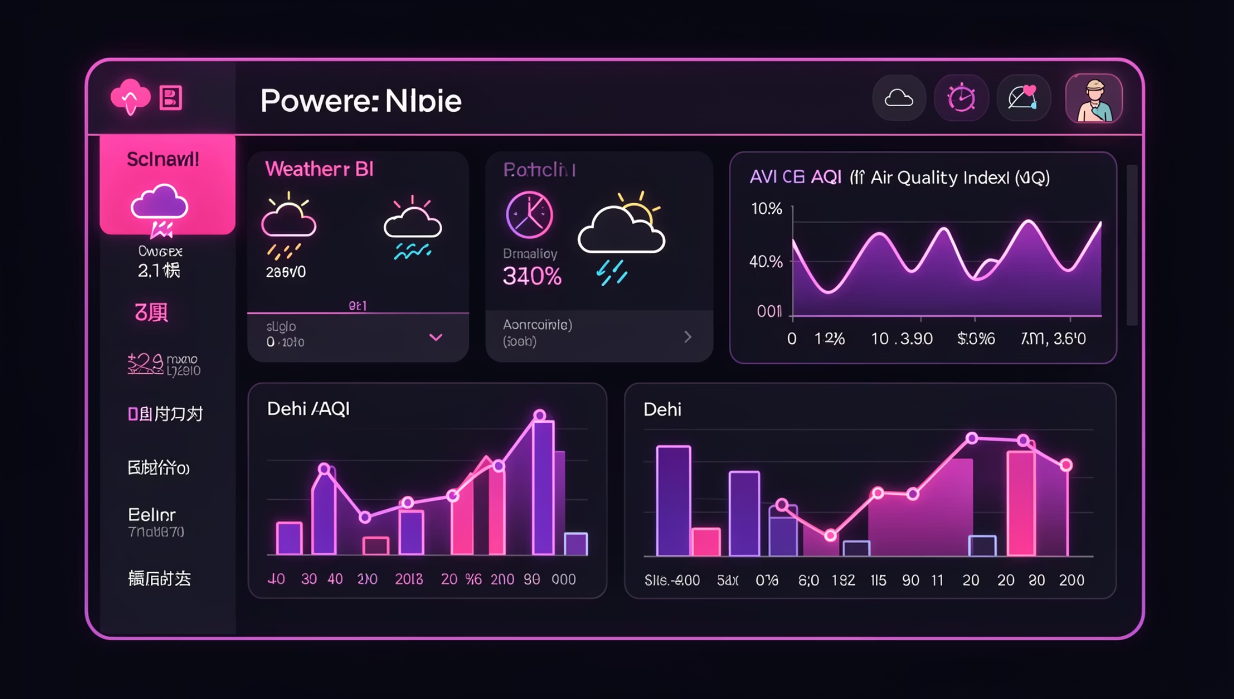
Dashboard Design & Key Features
The Power BI dashboard provides a clean, intuitive interface for exploring Delhi's environmental data:
KPI Cards: Snapshot views of Average Temperature, AQI, PM2.5, and PM10.
Visualizations: Includes monthly temperature trends, AQI trends, hourly AQI heatmaps, and PM2.5 vs PM10 contribution charts.
Interactivity: Filters by Month, Location, and Weather Condition for dynamic data exploration.

Slide 9




Future Horizons: Expanding Analytical Capabilities
Real-time Integration
Predictive Modeling
Integrate with live weather and AQI APIs for continuous monitoring.
Develop machine learning models for advanced AQI forecasting.
Comparative Analysis
Public Deployment
Conduct city-to-city or year-over-year environmental comparisons.
Publish the dashboard on Power BI Service for broader public access.

